Slide 1


New Driver Orientation

Slide 2


Agenda
Welcome to the Fundamental Family
  Fundamental Promise to Drivers
  Why We Make Promises to Drivers
Driver Management
  Contact Information
  Keys to Your Success
  Daily Dispatch
  Day with Customer
  Potential Challenges and Resolutions
  Wrap Up
Accounting
  How to Get Paid
Risk Management
  Approval to Work
  Maintenance
  Safety
  Human Resources – Benefits
Q & A
Notes:
Fundamental staff in New Hope is here to keep you driving safely and to support you on the road!
Recruiter to read

Slide 3
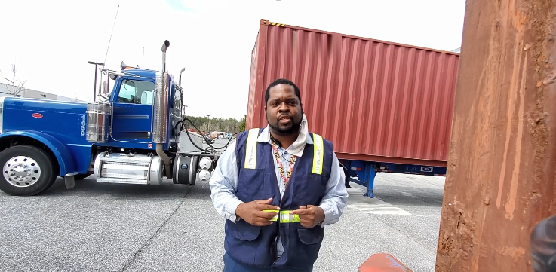
Welcome to the Fundamental Family
“The Driver Manager makes sure I get the loads that I want and work with the companies that I want. I really like that about FLS. It’s really personal and I feel likes it’s a family” – Donnell H.
Notes:
Today, we officially welcome you to the Fundamental family. Our business provides professional, CDL A & B drivers to our customers to drive their trucks. You are a hub in our business. It’s our goal to give you the work that allows you to have time that fits your lifestyle. We hope you like Fundamental as much as our driver, Donnell.
The recruiting group has guided you through the application process and now that you are all approved to work your key point of contact is… your driver manager.
From here on in, call your driver manager and he will work with you to get you working!
But if you think of any friends who may be looking to change jobs or for work please give me a call and we can get you a referral bonus.

Slide 4
Driver Management

Slide 5
Fundamental Promise to Drivers
Treat each of you as a member of the Fundamental Family
Work with you to accomplish your career goals
Set you up for success
Ensure you have a work-life balance
Be present and available when you need us the most
Help you solve problems and issues
Be open, honest, and transparent
Notes:
Driver Manager to read

Slide 6
Why We Make Promises to Drivers
Professional drivers are the key to the success of Fundamental and our customers.
This is a partnership between Fundamental, our drivers, and our customers.
During our 30+ years in business, the best practices for our drivers have become clear.
In this orientation, we will share these best practices. They will guide you and help our Driver Managers keep these promises.
Notes:
Driver Manager to read

Slide 7


DM: Driver Manager Introduction
Veronica is the lead Driver Manager and works with the drivers and customers in the Philadelphia Metro, NY Metro, and North Jersey territories. She also provides support to our other Driver Managers.
Veronica Paff
Notes:
Change to Veronica

Slide 8
DM: Contact Information
Phone: 877-357-7776 extension 2. This phone is answered 24 hours a day every day of the year including holidays.
Email: dispatch@fundamentallabor.com
Hours of Operation:
  Office hours for Driver Managers are 8:00 AM to 4:30 PM Monday through Friday.
  A Driver Manager is on call from 4:30 PM to 8:00 AM and all day Saturday, Sunday, and Holidays.
Please remember that we are available at any time to help you so give us a call when the need arises.

Slide 9
DM: Keys to Your Success: Availability
Let your Driver Manager know the days and times you wish to work:
Phone or email your Driver Manager every Friday and tell him what days you wish to work in the coming week. Your Driver Manager will enter your availability into our Driver Dispatch System.
Let your Driver Manager know what days you need to be off or want off for vacation.
Talk to your Driver Manager about any days that you may need to be done early or start later ahead of time. Your Driver Manager has the ability to work with our customers to try to accommodate your needs.

Slide 10
DM: Keys to Your Success: Scheduling
The above is an example of a drivers availability schedule in our driver management software program (Avionte).
Your Driver Manager will reference this calendar view to determine individual drivers daily availability and to schedule work assignments.

Slide 11
DM: Keys to Your Success: Communicating Changes
What to do if you are sick, going to be late, or need to book off an assignment:
  Call your Driver Manager or the on call Driver Manager before the start of your assignment; the more notice the better. That gives your Driver Manager time to let the customer know and try to fill the assignment with another driver.
  Please do not call the customer to call off of any assignment.
  Call your Driver Manager, who will take care of calling the customer for you.
  Remember you can call 24/7: 877-357-7776 extension 2.

Slide 12
DM: Keys to Your Success:
Control Your Work and Pay
How to make more money:
Be flexible, say yes to new customers and different start times. This will ensure you work as much as you want.
Customers typically request drivers they know. Working with a diverse set of customers opens up more opportunities to earn.
Call in your availability.
Provide great customer service.
Communicate with the customer and your Driver Manager.

Slide 13
DM: Keys to Your Success:
Enhancing Your Skills
How to build your experience:
Try new customers to learn additional skills. This will build your driving resume for the future.
  Drive and learn new equipment
  Handle, deliver, and pickup a variety of freight
  Learn new routes in cities and areas you are unfamiliar with
Take advantage of our online training.
Obtain hazmat endorsement or TWIC card.

Slide 14
DM: Your Daily Dispatch: The Basics
Your Driver Manager will match you with work daily for the following day. Monday dispatch will be completed on Fridays each week.
Orders from our customers are matched to the drivers skills and the timing requirements of the drivers that have reported as available.
You are free to accept or refuse any assignment offer.
If you accept, your Driver Manager will provide you the client’s information for the assignment and will place you as assigned to the client’s run in our Trucking Management Software (TMS).
Notes:
What is TMS?

Slide 15
DM: Your Daily Dispatch: The Details
You will then receive an auto generated Driver Start Sheet via email. The Driver Start Sheet will have all the information from the client that you need for your assignment the next day, including the following:
  Customer name, address and phone number
  The name of the person you report to
  If reporting blind, key and paperwork location will be provided
  Start time
  Equipment type, and type of freight
  Locations of deliveries and pickups
  Specific customer requirements and paperwork requirements

Slide 16
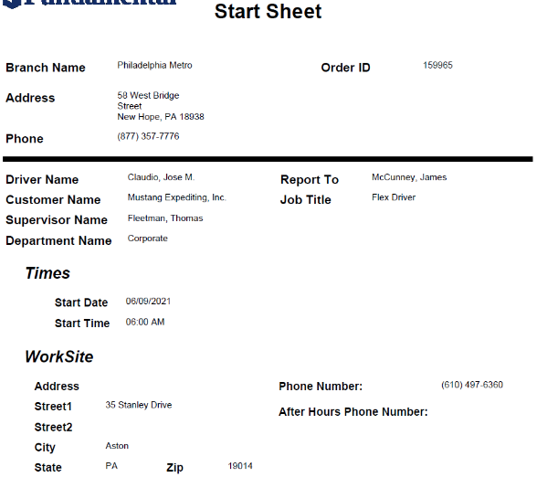
DM: Your Daily Dispatch: Start Sheet
To the left is a sample of the auto generated start sheet that you will receive by email when you accept an assignment
Your Name

Slide 17
DM: Your Daily Dispatch:
Travel or Commute Surcharge
The surcharge will apply when a customer is located more than 30 miles from your home using the shortest route from Google Maps.
Your Driver Manager will add a surcharge to your assignment to help you pay for the additional time needed to get to the customers location in certain circumstances.
Notes:
Is the surcharge to the customer? Or do we pay travel time?

Slide 18
DM: Your Daily Dispatch: Look the Part
We suggest that you dress in a manner that is safe and professional.
  We suggest the following:
    Long pants to protect your legs
    Work boots to protect your feet; consider steel toe work boots
    Tee shirt or polo
    Jacket in the winter months or if working in a reefer trailer
    Rain gear to keep you dry
    Eye protection and gloves
  Please note that some of our customer prohibit shorts. In the summer months please ask your Driver Manager if shorts are acceptable.

Slide 19
DM: Your Day with the Customer: Arrival
Park your vehicle, enter the customers location, introduce yourself, and ask to speak to the report to person on your Driver Start Sheet.
If you are reporting “blind,” your Driver Manager will have given you instructions about how to get your paperwork, keys, and truck assignment.
If asked, email the report to person your previous 7 days record of duty status (RODS) from your Motive App (formerly KeepTruckin).
The report to contact will go over the days work with you and give you your paperwork, keys, and truck assignment.

Slide 20
DM: Your Day with the Customer: Pre-Trip
Locate your truck and trailer and complete a pre-trip inspection.
A pre-trip inspection is a Federal Motor Carrier Safety Administration (FMCSA) requirements.
If you discover safety issues bring them to the attention of the report to contact and also call your Driver Manager for instructions.
Your Driver Manager will work with the customer to address the issues and get you on the road.

Slide 21
DM: Your Day with the Customer: Throughout Day
After every delivery and pickup is complete, the customer would like you to call the report to contact and let them know you have completed the stop.
If you are delayed by the receiver or shipper, or in traffic, the customer would like you to call the report to contact and advise them of the delay.

Slide 22
DM: Your Day with the Customer:
End of Day
Upon return to the customer, ask the report to contact where to park the trailer and tractor
Perform a post trip inspection and report and safety issues to the report to contact; this is a FMCSA requirement
Turn in all completed paperwork
Turn in keys
Before leaving, present the report to contact with your completed time sheet and ask him / her to sign off on your hours
You can then go home for the day

Slide 23
DM: Potential Challenges and Resolutions
You arrive at the customer and they are not open or the report to contact has not arrived:
  Call your Driver Manager and they will let you know what to do
  Don’t leave the location
Customer sends you home for any reason:
  Do not leave until you and your Driver Manager have worked out the issue together. This will include:
    Call your Driver Manager and let them know what is happening
    Driver Manager will call the customer to confirm and get a reason for sending you home
  You will be paid for the day

Slide 24
DM: Potential Challenges and Resolutions
Truck break downs:
  Call the report to contact and they will advise you on what to do
  Call your Driver Manager
Fuel:
  Always check fuel level before departing as part of your pre-trip inspection
  If you need fuel let the report to contact know
  The customer is responsible for fuel
Accident, incident, injury:
  Call your Driver Manager and they will help you
  Refer to the specific Risk Management training in this program

Slide 25
DM: Potential Challenges and Resolutions
Issues at delivery location including damaged product, overage, and missing product.
  Recount the product and verify
  Call “report to contact” for additional instructions
  Call your Driver Manager
Placed Out of Service by DOT
  Call the “report to contact”
  Call your Driver Manager and they will help you
Remember: the key to any situation you encounter is to communicate with the customer and your Driver Manager.

Slide 26
DM: Wrap Up
Welcome to Fundamental. We want you to succeed so please if anything about how we operate is unclear please call your Driver Manager or you can always call Jeff Muntz, V.P. Operations.
We look forward to a long relationship with you and thank you for choosing Fundamental.
Remember to communicate with your Driver Manager
At the end of the orientation there will be a Q and A session
After orientation, your Driver Manager will schedule a one on one session to get to know you better and discuss your start date
Notes:
Delete this slide?

Slide 27
Accounting

Slide 28

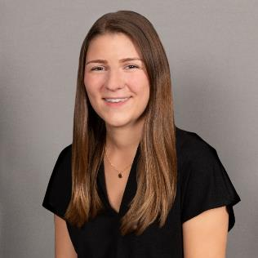
Accounting Department Introduction
Tammy Sadovy
Accounts Receivable Staff Accountant
Brieana Szarko
Payroll & Accounts Payable Staff Accountant

Slide 29
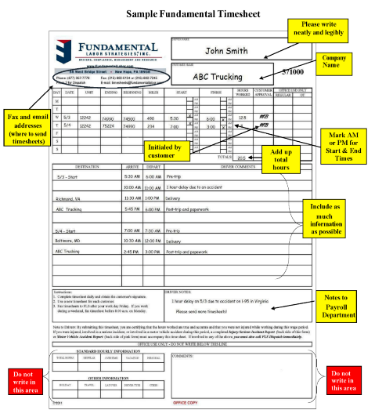
Acct: How to Get Paid
The Work Week is Monday – Sunday. There are some exceptions to this for certain clients.
Please send your timesheet to us by Sunday at 6 PM each week to ensure we pay you accurately and timely.
A sample time record appears to the left
Timesheets can be sent to us via
fax (215) 862-7245 or (215) 862-0134
or e-mail timesheets@fundamentallabor.com.
We gather all timesheets from the previous week on Monday mornings and use your start and finish times to calculate the hours you worked each day and the total for the week.
Notes:
Our main goal is to get our drivers (you) paid on time and accurately

Slide 30
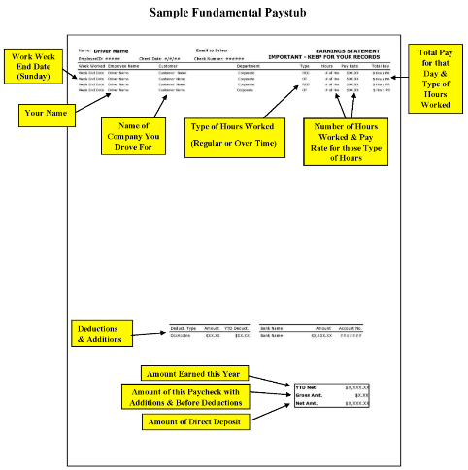
Acct: How to Get Paid
You will receive an email containing your paystub for the prior week by 5 PM on Tuesdays.
A sample paystub appears to the left
You will receive your paycheck via direct deposit on Thursday by midnight at the latest. Exception – In the case that a holiday falls on a Thursday, you will receive the direct deposit on Friday by midnight.
Payment methods include Direct Deposit and Rapid! Pay Card.
To change your payment method, please reach out to Brieana Szarko by email bszarko@fundamentallabor.com or by phone at 215-862-7280 Ext 5.
Notes:
Our main goal is to get our drivers (you) paid on time and accurately

Slide 31
Acct: Contact Information
Call (215) 862-7280 ext 5
or
E-mail FLS-Accounting@fundamentallabor.com
Notes:
Talk about FAQ’s
Fill out timesheets with drivers watching

Slide 32
Risk Management

Slide 33


Risk Management Department Introduction
Tiffany Montalto
General Manager- Risk
Darling Baez
Senior Risk Manager

Slide 34
RM: Approval to Work
Risk Management runs all of your background reports and reviews your file to make sure that you are DOT compliant and meet Fundamental standards.
We have run the following reports with your consent:
  MVR
  CDLIS
  DAC
  Criminal Report
  Full Query
  PSP Report
We are required to verify your employment history. We have 30 days to complete this, per DOT, so we allow you to start working while we work on the verifications. There may be times when you get a call from a Risk Manager, your Recruiter or Driver Manager asking for additional information to help us to do to this work.

Slide 35
RM: Maintenance Items
Maintenance items are the documents within a driver’s file that have expiration dates. All maintenance items must be kept current to continue to legally drive and/or meet DOT & FLS standards.
We keep track of the following items:
  Medical Card
  Driver Qualification (DQ) Card
  TWIC Card
  Driver’s License
  Minimum Driver Standards
  Letter Agreement
  Annual Review & MVR
  Drug and Alcohol Clearinghouse Query
All documents requiring a signature can be signed electronically either on your phone or computer. We will send you reminders via email and text.
  We will remind you about 2-3 weeks before the expiration date
  You will get at least 2 phone calls from us

Slide 36

RM: Motive App
Driver’s use the Motive (formerly KeepTruckin) app to track their Record Of Duty Status (RODS) to comply with the FMCSA regulations regarding Hours of Service (HOS).
Motive enables Fundamental drivers to provide their RODS to each customer when they report for work each day. It can be emailed to the customer and entered into their ELD.
The Motive App can be downloaded on either an Android or Apple device.
Risk Management has created a login for you, which you should have received via email. If you did not, please let us know.
If you already have an account with Motive you will need to sign in then connect to Fundamental by using our code under “Company Connection” in the settings KT3813923.
You also should have received instructions on how to use the Motive app.
Please download this app prior to your first run, if you haven’t already.

Slide 37
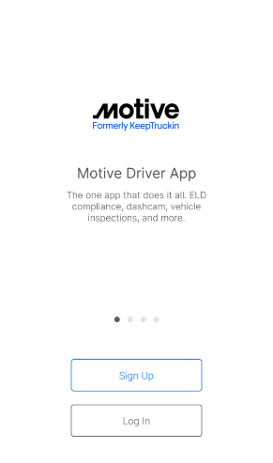
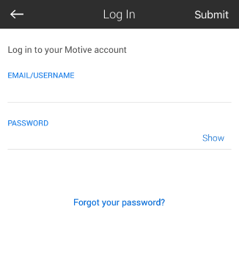
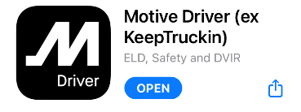
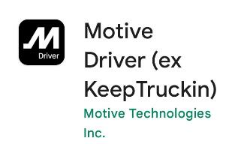
RM: Motive App
Apple
Android

Slide 38
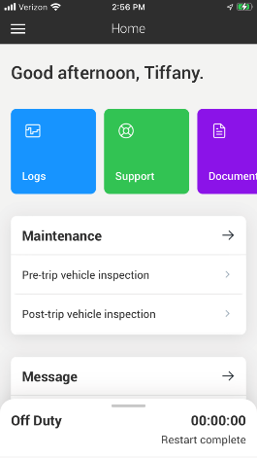
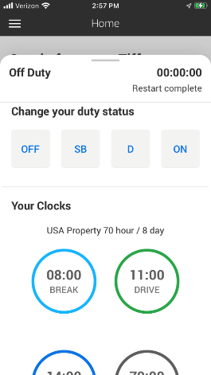
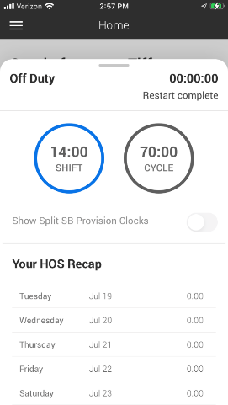
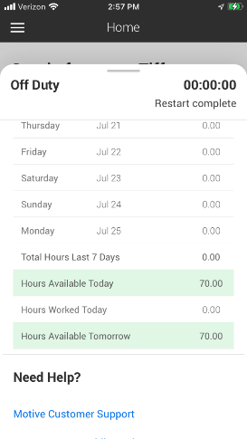
RM: Motive App

Slide 39
RM: DOT Drug & Alcohol Testing
DOT Pre-Employment Drug Test:
  All drivers are required to complete and pass before beginning work.
  Tested for: Marijuana, Cocaine, Opiates, Amphetamines and Phencyclidine (PCP).
Random Drug Test:
  You may be called by your Driver Manager to complete a random drug and/or alcohol test.
  You must go immediately when called.
  Failure to do so is a refusal under the regulations and prohibits you from driving.
Reasonable Suspicion Drug Test:
  When and if a trained supervisor suspects that a driver is using (or under the influence of) a controlled substance and/or alcohol.

Slide 40
RM: DOT Drug & Alcohol Testing
Post-accident testing occurs under the following circumstances:
  If the accident results in the loss of human life, or
  If the accident results in bodily injury that requires medical treatment at the scene or ambulance transport, or
  If one or more vehicles incur disabling damage requiring the vehicle to be towed from the scene, or
  If you receive a citation from the police for a moving violation.
Post-injury testing occurs after a work related injury requiring medical treatment.
Regulations prohibit the use of any alcohol for four (4) hours before driving a commercial vehicle and the carrying of any alcohol.
A copy of our Drug and Alcohol Policy was provided during your application process. If you need an additional copy, please let us know.

Slide 41
RM: Drug & Alcohol Clearinghouse
The Clearinghouse contains all drug and alcohol violations that occurred on or after January 6, 2020.
Fundamental requests a Full Query before you work. A Full Query lists any drug and alcohol violations in your record.
Once a year, we request a Limited Query that shows if there are any records in the Clearinghouse. You do not need to consent each time; we have your signed release.
If there are records, we would ask you for your written consent and then request a Full Query to see what those violations are, and
After you start with us, if you don’t have any future violations, and don’t apply for another job, you would never need to use the Clearinghouse portal.

Slide 42
RM: Safety: Accidents & Incidents
In the event of an accident (collision with another vehicle) or an incident (collision with an object), we are here to help manage these issues with you to achieve the best possible outcome for you.
Your Driver Manager should always be your first call, regardless of the time or day. They will then direct you to a Risk Manager. Risk Managers are on call 24/7/365 in the event of an accident, incident or injury.
Take pictures of all damage (minor or major) and the surrounding area. Collect and give us all information you get from the other party involved and/or the police.
Complete an FLS Accident Report or Incident Report. This can also be completed in the Tenstreet Pulse App.
You may be assigned follow up training.
The sooner you report the event and provide all necessary information, the sooner we can get you back to work.

Slide 43
RM: Safety:
Accident Scene Best Practices
Do not discuss the accident with any witnesses at the scene or any of the other parties involved in the accident.
Do not admit fault, negligence or liability. Do not offer to pay for any damage.
Cooperate with the police, but do not guess or speculate in response to any questions—particularly regarding vehicle speeds or distances. If you don’t know or can’t recall something, just say so.
Take as many photographs as possible. Photograph forensic evidence (skid marks, broken glass) and take measurements if possible.
  Photograph damage (up close and from afar).
  Photograph vehicles from multiple distances and perspectives.
  Photograph any roadway mile markers, signs, barriers, obstructions, or curves in the roadway. Do not photograph any injured parties.
Obtain the names, addresses, phone numbers, and license plate numbers of any parties or witnesses.
Do not complete any other written reports for anyone until you have spoken with someone from FLS Risk Management Department

Slide 44
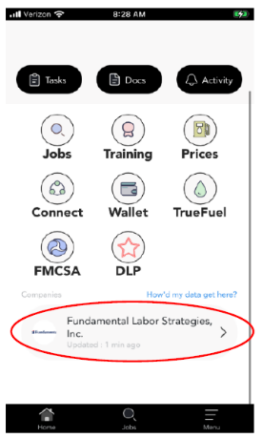
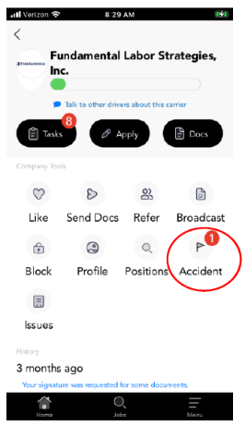
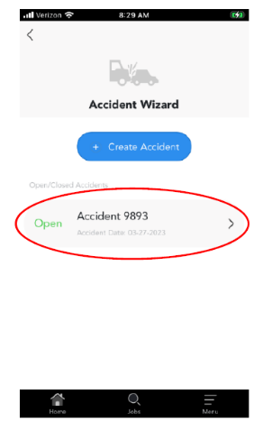
RM: Safety: Pulse App-Accident Report

Slide 45
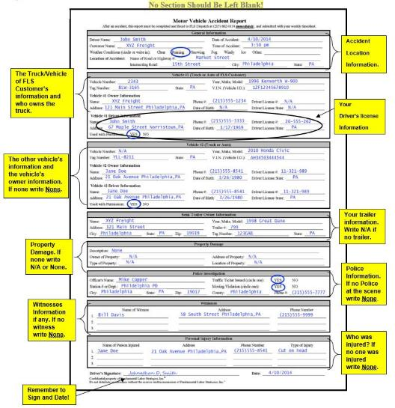
RM: Safety: Accident Report

Slide 46
RM: Safety: Injuries
If you are injured on the job, you are covered through an Occupational Accident Policy.
Call your Driver Manager immediately and they will direct you to a Risk Manager who will support and guide you through your injury.
We will submit a claim on your behalf, which will help streamline the process.
We want you to be safe and to get you back to work as soon as possible, so we will keep in contact with you throughout the process.
We will ask you for a full duty release from your treating doctor to make sure you that you are at your best when you start working again. We want to avoid any further injuries.

Slide 47
RM: Safety: Injury Report

Slide 48
RM: Safety:
Injury Prevention Best Practices
Always use three points of contact when getting into or out of a truck or trailer & always face the equipment.
Never jump from the cab, trailer, or steps.
Be aware of your surroundings at all times & pay attention to possible hazards, obstacles, or dangerous conditions.
Lift with your legs, NOT your back.
Avoid bending & twisting.
Never try to catch something heavy from falling.
Utilize equipment such as pallet jacks, if available, & ask for help, if needed.

Slide 49
RM: Safety: Cellphone Use
Fundamental is committed to complying with all DOT regulations, and we fully support and enforce the “No Texting Rule” and “Mobile Phone Restrictions”.
The FMCSA restricts the use of all hand-held mobile devices and restricts a CMV driver from holding a mobile device to make a call or dialing by pressing more than a single button.
CMV drivers who use a mobile device, may only use the device in a hands-free mode.
Violations of these rules carry a penalty of up to $2,750. Drivers are responsible to pay these penalties.

Slide 50
RM: Safety: Training
Your safety is our top priority.
The DOT recommends ongoing safety training that will help reduce incidents, accidents, injuries, and create a safer work environment.
We utilize an online training platform that can be easily accessed from your phone or computer.
  You will receive monthly training assignments, as well as post-accident, incident and injury training.
We also email monthly Safety Newsletters to keep you up to date on industry information and trends.
We appreciate & acknowledge our safe drivers by sending safety post cards, certificates, and gift cards.
Notes:
Add detail that encourages them to earn safety recognition

Slide 51
RM: Safety: Tenstreet
Monthly training is assigned and completed through Tenstreet.
You will receive an email once your training has been assigned.
If you have Tenstreet’s Pulse app, you will also get a notification through the app.
There is no username or password to login, just click on the link in your email, or the app, and enter your personal information (see next two slides).
As a reminder, you will need to complete your training before your Driver Manager can offer you your first run.

Slide 52
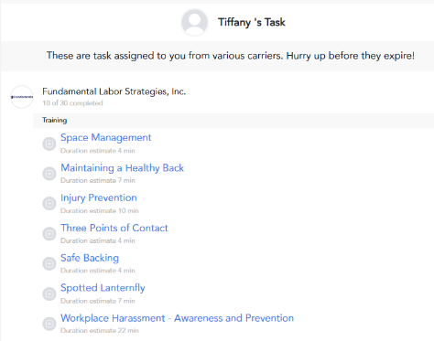
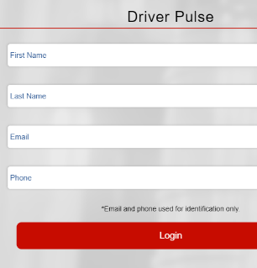
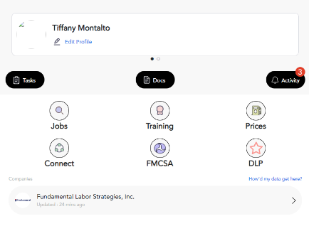
RM: Safety: Tenstreet’s Pulse App

Slide 53
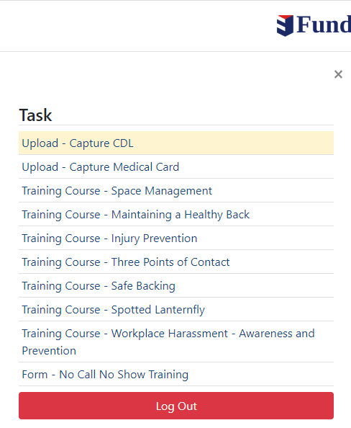
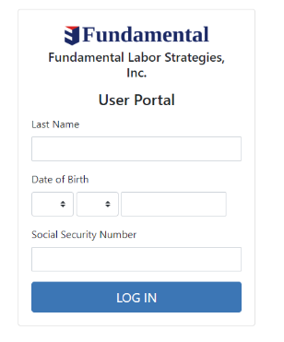
RM: Safety: Tenstreet- No Pulse App

Slide 54
RM: Human Resources: Benefits
FLS sponsors a benefits program through IHA Health which is specifically designed for truck drivers who are Independent Contractors.
There are 6 Comprehensive plans to choose from.
  Plans start at under $90/week
Voluntary Benefits through Sun Life:
  Vision
  Dental
  Hospital Indemnity
  Accident Insurance
  Life Insurance and AD&D Insurance
  Critical Illness Insurance
Drivers can sign up at anytime throughout the year.
IHA Toll Free Number: (888) 376-9811
Hours: M-F 8:00am-8:00pm EST
Website: www.ihaenroll.com
An IHA representative will contact you not long after you start to review benefit options with you.

Slide 55
RM: Human Resources: Tax Help
FLS has a relationship with a company called ATBS that can support independent contractors with services:
  Tax Filing
  Accounting
  Bookkeeping
  Tax Help
The cost is $49.99/month
The service provides a personal tax consultant at no additional cost
There is an ATBS app by which you can upload receipts and documents.
ATBS contact information is as follows:
  1-866-920-2827
  www.ATBS.com

Slide 56
RM: Contact Information
If you have any safety, compliance, or HR related questions, issues, or need to send us anything, our contact information is below:
  Phone: 215-862-7280 x894
  Email: riskmanagement@fundamentallabor.com
  Fax: 215-862-0134 Attn: Risk Management
Please feel free to reach out if we can be of assistance.

Slide 57
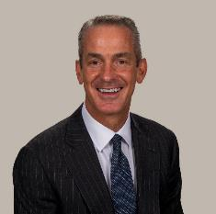
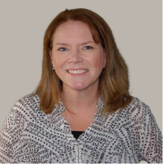
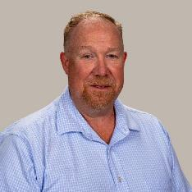
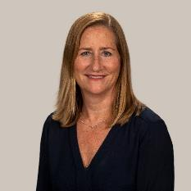
Meet the Rest of the Team
Curtis Ball
President
Kathy Krueger
Vice President
Jeff Muntz
Vice President – Operations & Recruiting
Cinda Ball
Vice President –Marketing

Slide 58
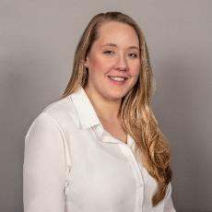
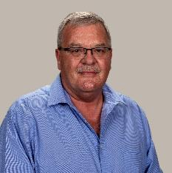




Meet the Rest of the Team
Victoria Wooden
Recruiter
Ken Nace
Senior Recruiter
Kelly Brown
Recruiting Manager
Shelby Prizer
Corporate Marketing Administrator
Jennifer Hudson
IT Manager & Corporate Analyst
Brandon Whatley
Account Manager

Slide 59
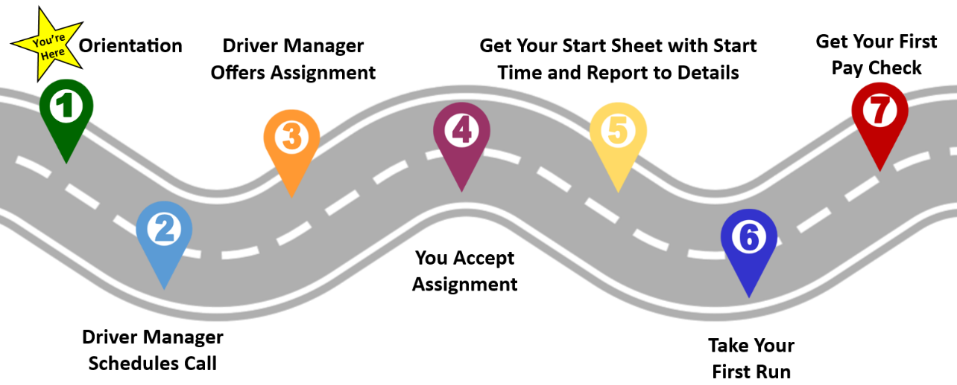
What Happens Next
Notes:
Take out set start date (3)
Add get your first pay check at the end (7)

Slide 60
Your Point of Contact
Your main point of contact will now be Driver Management. Contact them at:
Phone: 877-357-7776 extension 2
Email: dispatch@fundamentallabor.com
Your Driver Manager will reach out today.

Slide 61
Q & A

